Slide 1


Smart Home Security System: A Comprehensive Approach
Smart homes are increasingly vulnerable to cyberattacks. This presentation outlines an AI-powered security assessment tool to proactively identify and mitigate these risks, safeguarding your home and your data.
Made by:
Burhanuddin Master
Abhyudit Agrawal

Slide 2
AI's Role in Enhancing Smart Home Security
Vulnerability Detection
Anomaly Detection
AI-powered scanners can identify security vulnerabilities in smart home devices, proactively addressing potential weaknesses.
AI algorithms can monitor network traffic and identify unusual activity, providing real-time alerts for suspicious behavior.

Slide 3
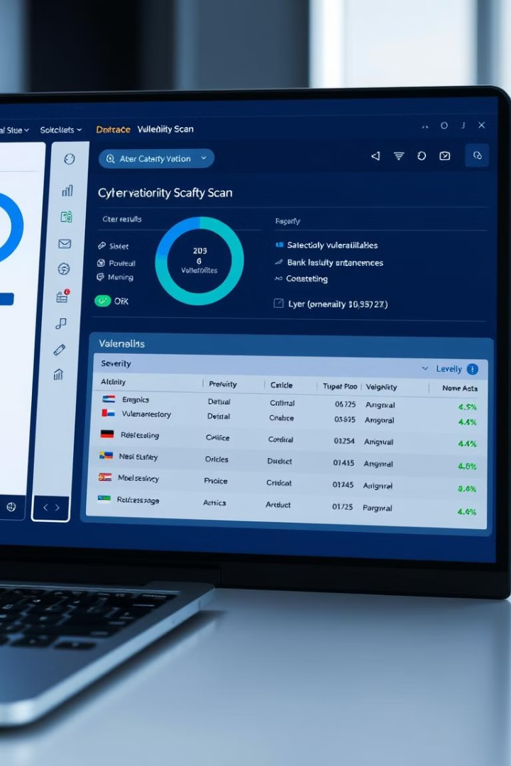
Developing a Device Vulnerability Scanner
Network Scanning
Device Fingerprinting
The scanner identifies all connected devices on the home network.
The scanner analyzes each device's communication patterns and identifies its vulnerabilities.
Security Patching
The scanner recommends and implements security patches for vulnerable devices.

Slide 4
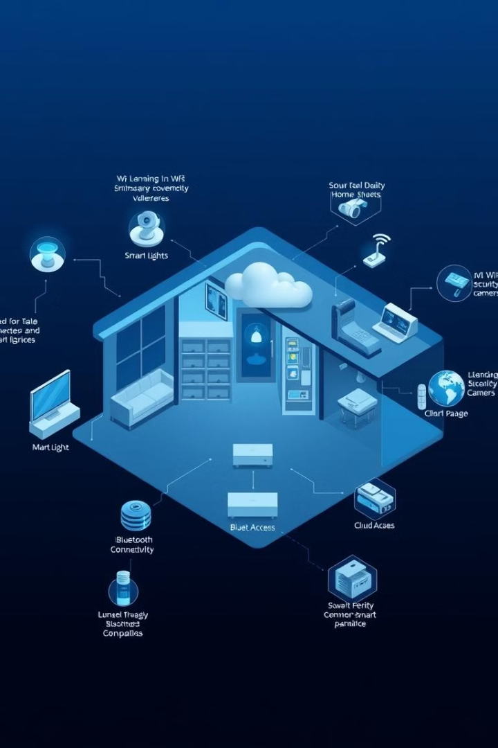
Threat Models for Smart Home Networks
1
Data Leakage
Unauthorized access to sensitive data stored on smart home devices.
2
Device Hijacking
Taking control of smart home devices for malicious purposes.
3
Denial of Service
Disrupting the functionality of smart home devices.

Slide 5
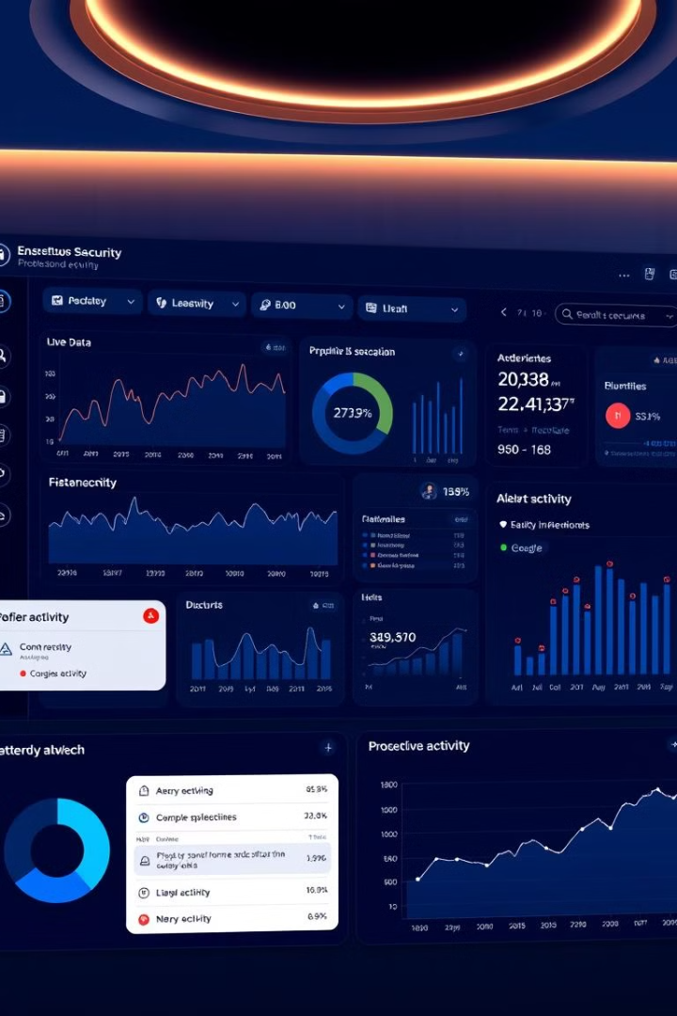



Real-time Monitoring and Anomaly Detection
Activity Logs
Behavioral Analysis
Recording all device interactions and network traffic.
AI algorithms identify deviations from normal device behavior.
Threat Intelligence
Leveraging real-time information about known cyber threats.

Slide 6



Data Privacy Concerns in Smart Homes
Data Collection
1
Smart devices gather personal data, including location, habits, and preferences.
Data Sharing
2
Data is shared with third-party services and companies, raising privacy concerns.
Data Security
3
Protecting personal data from unauthorized access and breaches.

Slide 7
Designing a User-friendly Dashboard for Security Insights
Device Status
1
Displays the security status of each connected device.
Security Alerts
2
Provides real-time notifications of suspicious activity.
Actionable Recommendations
3
Offers guidance on mitigating identified vulnerabilities.

Slide 8
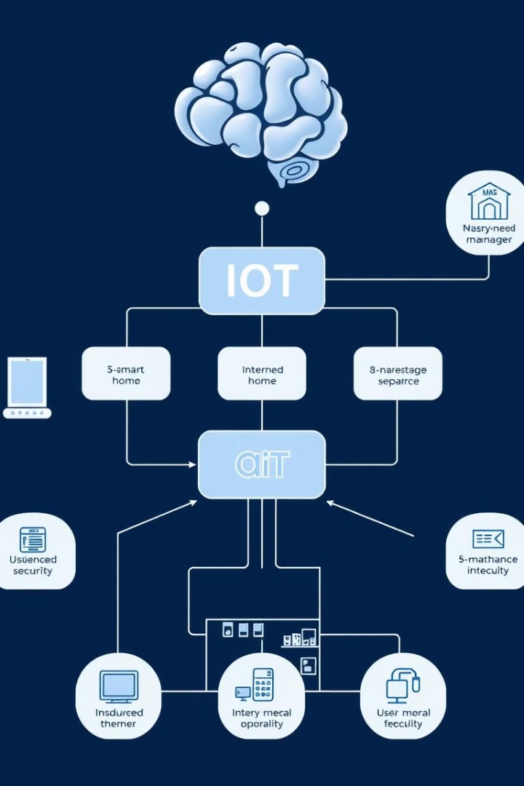
Integrating AI with IoT Device Management
1
2
Device Onboarding
Access Control
Automated security checks during device setup.
AI-powered authentication and authorization systems.
3
Remote Management
AI-assisted control and management of smart home devices.

Slide 9


Cybersecurity Standards for IoT Devices
NIST Cybersecurity Framework
OWASP IoT Top 10
Provides a comprehensive set of cybersecurity standards for IoT devices.
Identifies the most common security vulnerabilities in IoT devices.

Slide 10
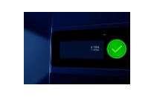
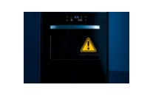
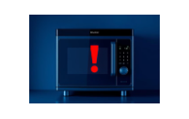
THANK YOU

